Slide 1

Product Based Monthly Prediction and Tracking of Plastic Packaging Weight
Ersan Kucukoglu
Capstone Project
Msc in Business Analytics
Central European University
Department of Economics and Business
Budapest, June 2022

Slide 2
Background
The retailer company aims to lower the negative effect of the plastics on the environment. In order to do that the business goal is to lower the sold plastic packaging with their product by 20% till 2025. By developing a data product which calculates the KPI of sold plastic packaging by the HU-contracted suppliers in tones and compare it to the goals an instant intervention would be possible in case of a risk.

Slide 3
Key problems:
evaluating the business goals is done quarterly
there is only a high effort possibility to follow the measures within the year, no forecast is available
Objectives:
building a data product, which allows the user to see the sold plastic packaging in tones and to compare it with the business goals also by seeing the predicted outcome till end of business year
Solution type:
dashboarding + prediction

Slide 4







Methods of approach
Data-science methods to be used:
Model based prediction, data-cleaning, dashboarding. (Sales and goods-in based.)
Receipt data analysis
Predicting yearly outcome
Importing main item data
Dashboarding, creating visualization
Software and Tools:

Slide 5

1
Importing Data
Data Cleaning
Data Exploration
Time Series Analysis
EWMA
Forecasting Models
Persistence Algorithm (baseline)
Holts-Winters
SARIMA
SARIMAX
PROPHET
LSTM
2
The Process of Analysis
3
SQL Dashboard

Slide 6



About the Data:
Available Data:
Receipt data
Item main data
Plastic Packaging
Content data
1
Monthly Aggregated Data:
Currently 2402 rows, 9 columns
Date Index: Jan 2014 -> June 2022 (Monthly)
40 Unique Plastic Packaged Items
2
Monthly Forecasted
Data:
Currently 344 rows, 7 columns
Date Index: June 2022 -> March 2023 (Monthly)
3
Forecast for the future data
Merge Datasets
SQL Dashboard

Slide 7
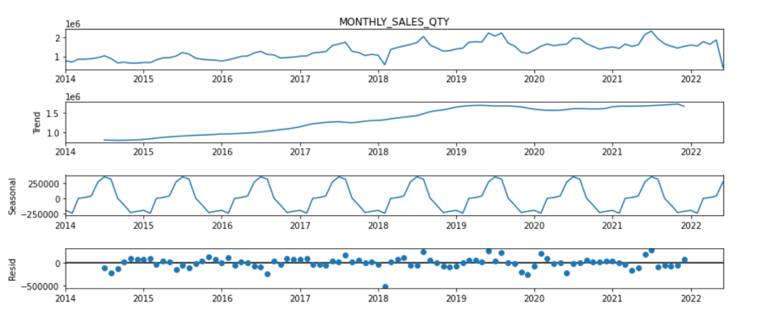
Time Series Analysis
General trend upwards
Peak sales during the summer months
Seasonality

Slide 8
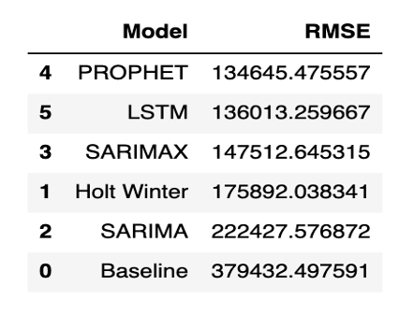
Forecasting Models
With the Persistence Algorithm 6 different models created, Holts-Winters, SARIMA, SARIMAX, PROPHET and LSTM for the time series data by following; choose a Model, split data into training and test sets, fit the model on the training set, evaluate the model on the test set, re-fit the model on entire dataset, forecast for the future data. RMSE is more sensitive to outliers and RMSE has the benefit of penalizing large errors more so can be more appropriate in some cases.
According to the table below, the model that works best according to the RMSE value is the Prophet Model. By examining the components of the prophet model, we can see that it can identify key trends in the data. The overall trend represents the overall increase in sales. It accurately depicts the annual seasonality, so it's understandable why the performance was reasonably good. Prophet's is more convenient, as LSTMs are trained on time-series windows out of context and do not necessarily account for seasonality in the data. In the next stage, Prophet will be used as the forecasting model in the calculation of the amount of plastic packaging.

Slide 9
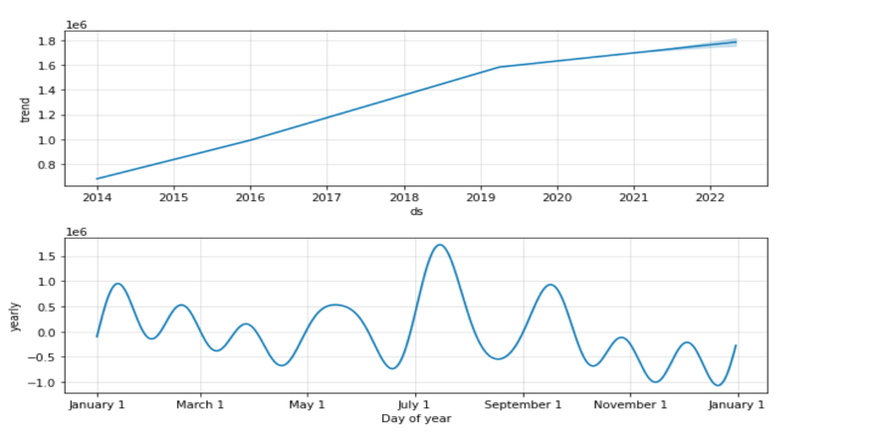
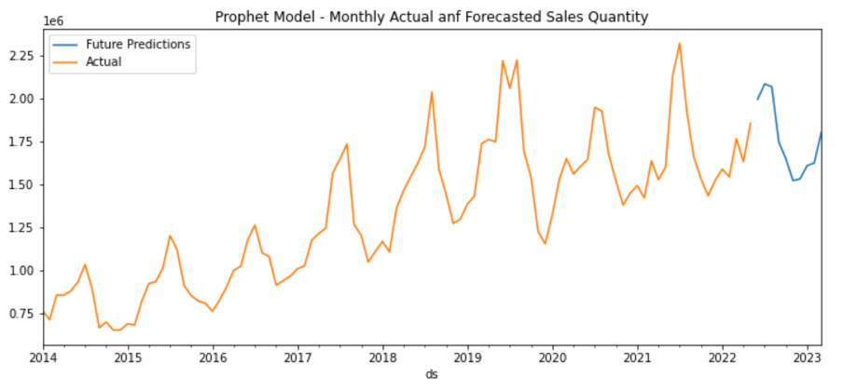
Prophet Model
Prophet takes a dataset with two attributes as input. The first of these features is the ds timestamp, and it supports time formats that can be handled by pandas, a Python data manipulation library. The other feature, y, is the numerical measurement value that is the subject of the estimation. The model trained with the data set containing ds and y values can produce predictions in different periods. The intuitive approach to the operation of the Prophet model allows to create effective predictions without drowning in the details of the data.
RMSE: 134645.47 (lowest)

Slide 10
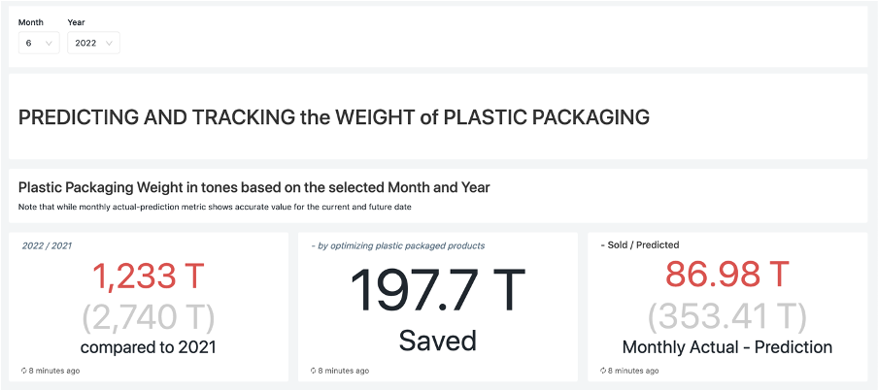
Outcomes
These three data card shows (I) total weight of plastic packaging sold for the current year and previous year, (II)the total amount of plastic weight saved during the year, (III) the monthly current plastic packaging weight used according to the selected month and the predicted value for that month. With these 3 data cards, the dashboard gives general information about the weight of plastic packaging on a monthly and yearly basis.

Slide 11
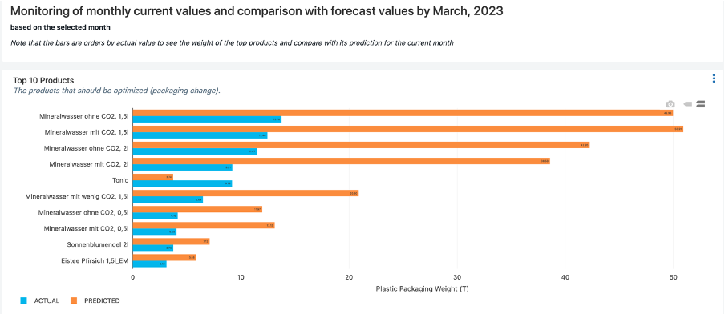
Outcomes
The bar plot shows item-based data. Here, the 10 products with the highest plastic packaging weight on a monthly basis are shown with their predicted value for that month. The bars are ordered by actual value to see the weight of the Top 10 items for the current month. At the same time, the dashboard shows you the top 10 products from the past months (already sold) and the next months (predicted), with the help of widgets.

Slide 12
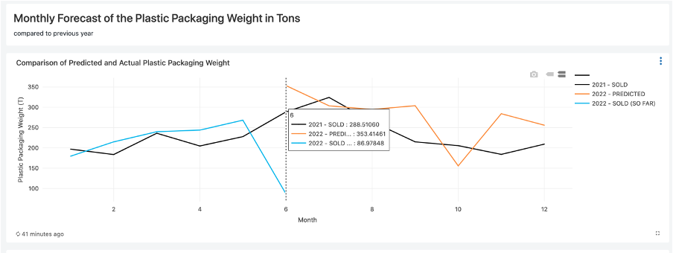
Outcomes
The line graph shows the forecasted, actual values of the total weight of plastic packaging in tons per month, and also provides the opportunity to compare with the data for 2021. For example, there is a prediction of how many tons of plastic has been used so far in June this year, how many tons were used last year, and how many tons will be used. Meanwhile, the predicted value shows well that June is in the trend of the 2021 value.

Slide 13
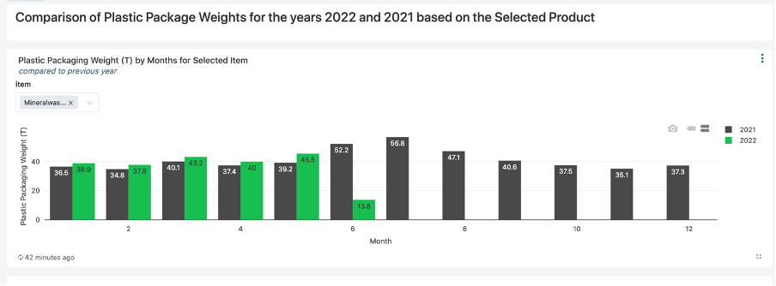
Outcomes
This is the bar graph showing the monthly total weight of the selected items. After selecting the product or more than one product with the help of the widget, the dashboard presents the data for this year and last year for that product according to the months. How the sales of the product changed according to the months and a comparison with the last year can be made.

Slide 14
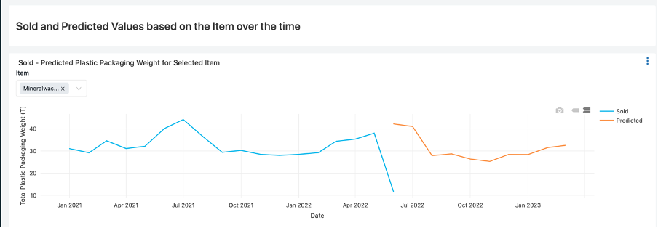
Outcomes
The figure shows the amount of plastic packaging of the selected product over time and the forecasted data for the future. For the Mineralwasser product selected here, the forecast follows the seasonality by considering the 2021 data. Note that the Sold quantity for June 2022 is expected to be close to the predicted value at the end of the month, as it has not been completed yet.

Slide 15
Summary
In this project, it was aimed to reduce the plastic packaging sold (in t), and in this context, the client aimed for a data product as project output that allows the user to see the plastic packaging sold in tons and compares it with the business targets by seeing the predicted result until the end of the business year.
In order to achieve these goals,
Data cleaning and exploration was done,
Time Series Analysis was performed,
Forecasting models were built to predict the plastic packaging weight for each item.
Prophet model was selected as the best model based on its RMSE,
monthly predicted values were created until March 2023, at the end of the business year.
In the final, a SQL Dashboard was created, with reproducible notebooks as output, in which
plastic packaging weight can be observed according to various filters such as a month, year, and item,
showing forecasts for the coming months,
showing the top 10 items based on most plastic packaging is used for the current month and next months.

